Slide 1
Abstract Data Structures
TOPIC 5.0 – ABSTRACT DATA STRUCTURES
TOPIC 5
5.1.14 – 5.1.17: Trees

Slide 2

REVIEW REVIEW REVIEW REVIEW REVIEW REVIEW
THE WARM-UP QUESTION
Recall the diagrams for inserting and deleting data from a linked list
Draw a representation of one of these two actions

Slide 3
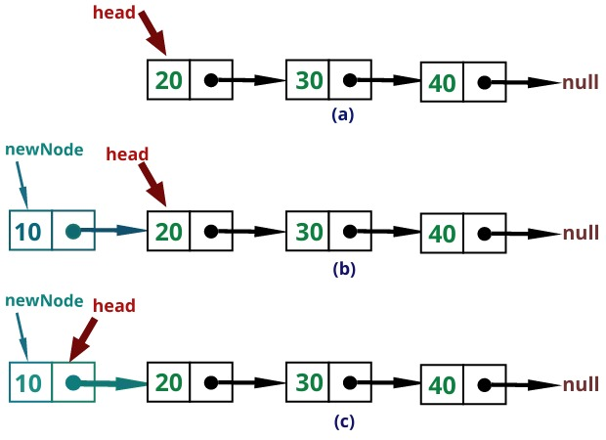
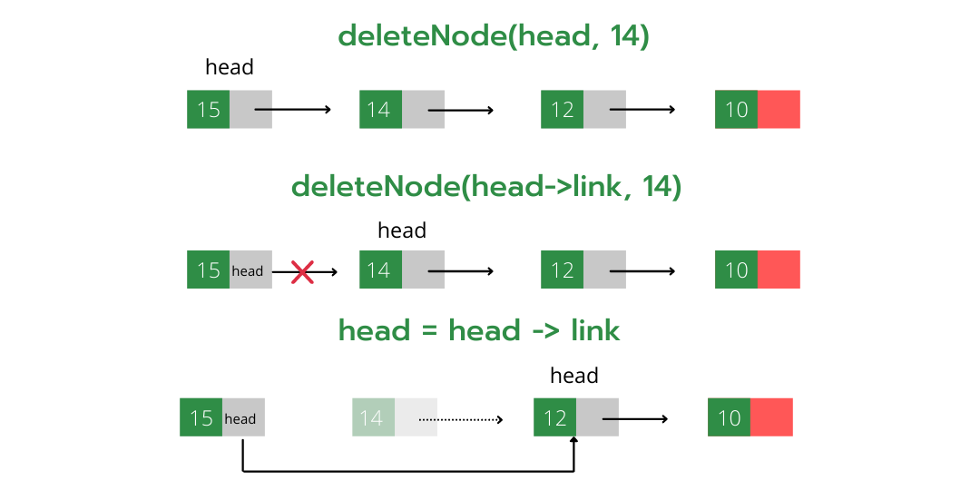
REVIEW REVIEW REVIEW REVIEW REVIEW REVIEW
THE WARM-UP ANSWER

Slide 4

Topic 5.1.14 – ABSTRACT DATA STRUCTURES
Trees
Trees are another abstract data structure
They are similar to lists, in having nodes and references to other nodes
The structure of a tree is… treelike though

Slide 5
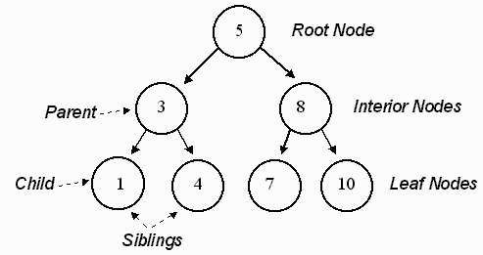
Topic 5.1.14 – ABSTRACT DATA STRUCTURES
Trees
Trees are nodes linked together to form a more complex abstract data structure
If flipped upside down, they kind of resemble actual trees

Slide 6
Topic 5.1.14 – ABSTRACT DATA STRUCTURES
Binary trees
Binary trees are trees where each node may only have two child nodes
They are the easiest trees to program
The image on the right depicts a binary tree

Slide 7
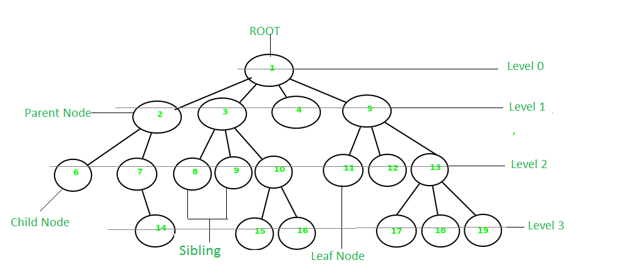
Topic 5.1.14 – ABSTRACT DATA STRUCTURES
non-Binary trees
Non-binary trees allow nodes to have as many children as they want

Slide 8
Topic 5.1.15 – ABSTRACT DATA STRUCTURES
Tree vocab
Parent – the node above a given child node
Left-Child – the node branching off to the left of a node
Right-Child – the node branching off to the right of a node
Root – the top node of a tree
Leaf – a node without any child nodes

Slide 9
Topic 5.1.15 – ABSTRACT DATA STRUCTURES
Tree vocab
Siblings: Nodes that share a parent node
Edge: The connection between a parent and child node
Key: The data field in a node, what it contains other than references to other nodes
Height: Number of edges to get from the root node to the furthest down leaf

Slide 10
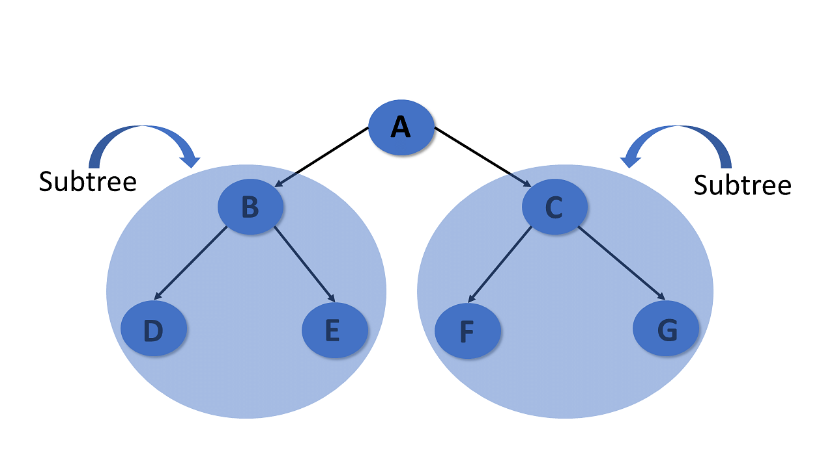
Topic 5.1.15 – ABSTRACT DATA STRUCTURES
Subtrees
Subtrees are created when a different node is chosen to be the root of a tree

Slide 11
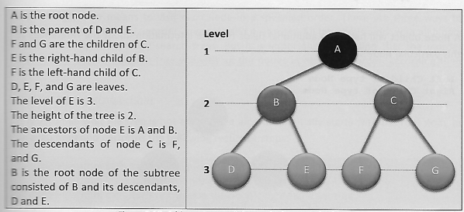
Topic 5.1.15 – ABSTRACT DATA STRUCTURES
Vocab bomb

Slide 12
Topic 5.1.15 – ABSTRACT DATA STRUCTURES
Tree traversal
How do we access all of the items in a tree? It isn’t as easy as going down the line like it is with a Linked List
We have three ‘Tree Traversal’ algorithms called
Inorder
Postorder
Preorder

Slide 13
Topic 5.1.15 – ABSTRACT DATA STRUCTURES
Inorder
Inorder traversal is a logical traversal of the tree
Steps:
Traverse the left subtree recursively
Visit the root node and process its data
Traverse the right subtree recursively
Next slide will have a visual demonstration of how this works

Slide 14
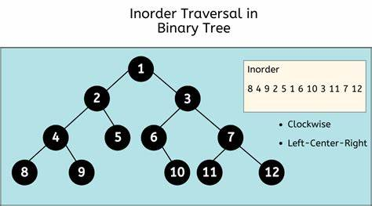
Topic 5.1.15 – ABSTRACT DATA STRUCTURES
Inorder

Slide 15
Topic 5.1.15 – ABSTRACT DATA STRUCTURES
Postorder
Postorder traversal is a child first traversal of the tree
Steps:
Traverse the left subtree recursively
Traverse the right subtree recursively
Visit the root node and process its data
Next slide will have a visual demonstration of how this works

Slide 16
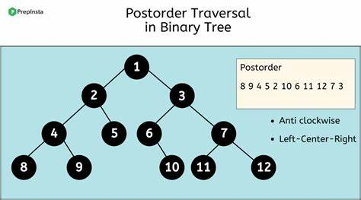
Topic 5.1.15 – ABSTRACT DATA STRUCTURES
Postorder
1

Slide 17
Topic 5.1.15 – ABSTRACT DATA STRUCTURES
PREorder
Preorder traversal is a root first traversal of the tree
Steps:
Visit the root node and process its data
Traverse the left subtree recursively
Traverse the right subtree recursively
Next slide will have a visual demonstration of how this works

Slide 18
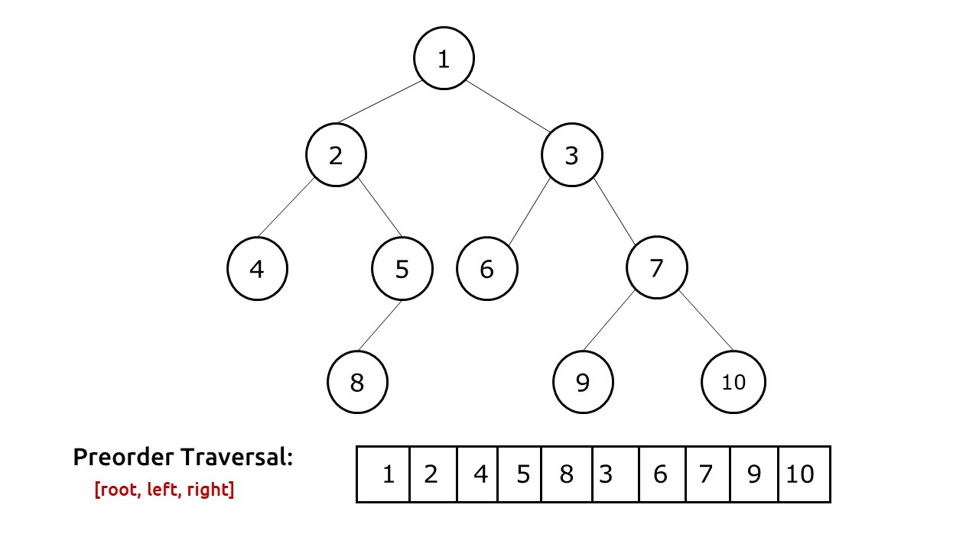
Topic 5.1.15 – ABSTRACT DATA STRUCTURES
PREorder
1

Slide 19
Topic 5.1.15 – ABSTRACT DATA STRUCTURES
Binary SEARCH Tree
These trees are cool and all, but they seem like less efficient ways to just have a linked list
Well, there is a specific kind of tree that provides us with lots of benefit
The Binary Search Tree (Hopefully ‘Binary Search’) is coming back to you on this?

Slide 20
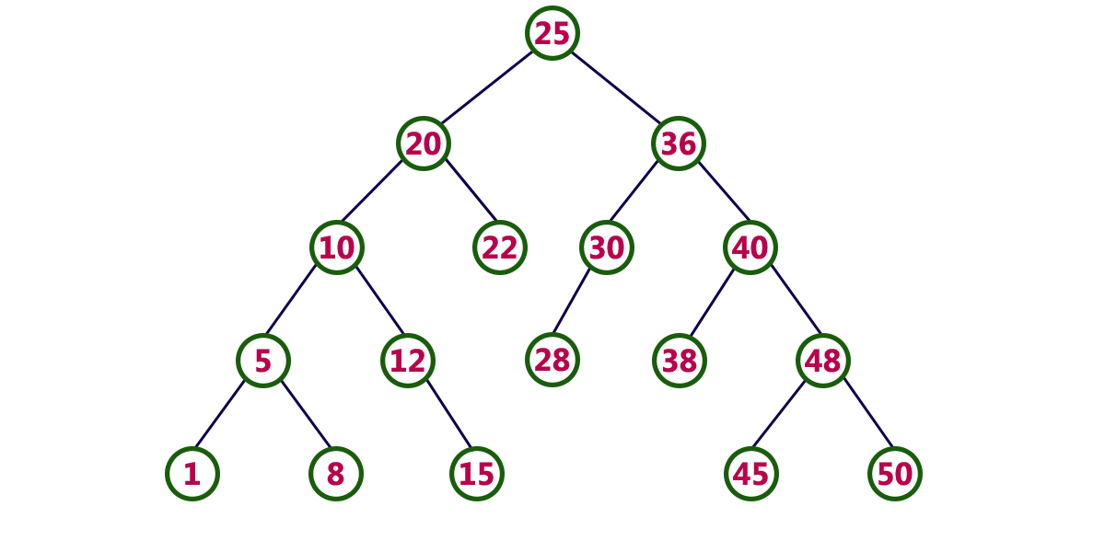
Topic 5.1.15 – ABSTRACT DATA STRUCTURES
Binary SEARCH Tree
A binary search tree is a specifically formatted Binary tree where each item on the left of a node is less than that item, and each item on the right is greater than that item

Slide 21
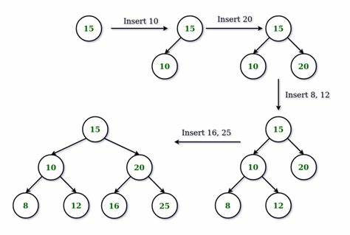
Topic 5.1.15 – ABSTRACT DATA STRUCTURES
Binary SEARCH tree insertion

Slide 22
Topic 5.1.15 – ABSTRACT DATA STRUCTURES
Binary SEARCH Tree INSERTION
If the BST is empty, make it the root node
If the BST is not empty, follow the root to the parent of the node that you’re trying to insert. This parent will be a leaf node.
If the key of the new node is smaller than the key of the parent, connect the new node as the parent’s left hand node
If the key of the new node is larger than the key of the parent, connect the new node as the parent’s right hand node

Slide 23
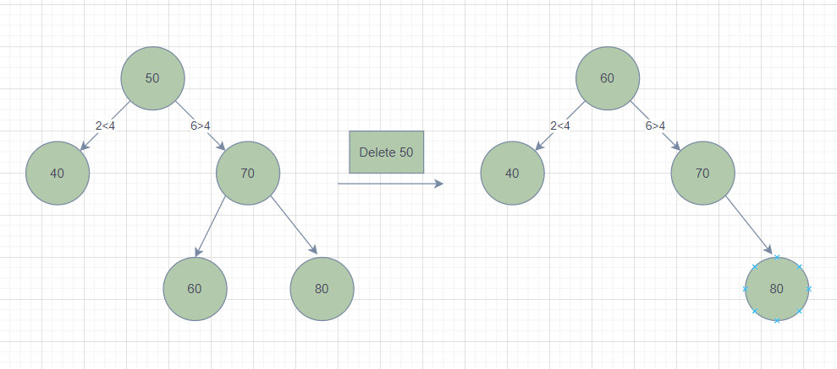
Topic 5.1.15 – ABSTRACT DATA STRUCTURES
Binary search tree DEletion

Slide 24
Topic 5.1.15 – ABSTRACT DATA STRUCTURES
Binary search tree Visualizer
Binary Search Tree, AVL Tree - VisuAlgo
https://visualgo.net/en/bst

Slide 25
Topic 5.1.15 – ABSTRACT DATA STRUCTURES
Binary tree add/delete
A non search tree will have items added at the first available spot, not needing to sort them

Slide 26
Topic 5.1.15 – ABSTRACT DATA STRUCTURES
Tree exercise
Draw diagrams of a BST (Binary search tree) having 10 nodes added to it
Then, remove 5 of those nodes

Slide 27

Topic 5.1 – THINKING RECURSIVELY
VOCAB TO REMEMBER
Tree
Binary Tree
Binary Search Tree
Node
Leaf
Child
Parent
Sibling
Edge
Key
Height

